Slide 1
Weapon Detection in Real-Time CCTV Videos Using Deep Learning
Batch No : 4
Battina Nandini(Y19CS003)
Choday Swetha(Y19CS024)
Chittemsetty Roopa Devi(Y19CS023)
Guided by
Dr.R.Lakshmi Tulasi Mam
Incharge:
Dr. B. Vara Prasad Rao

Slide 2
Contents
Problem Statement
Abstract
Flow Chart
Architecture
Datasets
Requirements

Slide 3
Problem Statement
In this paper, we tackle the problem of detecting the presence of weapons within an image.
We want to learn a function that given an image as input returns the presence and the location of the weapon.
Weapon detection presents some peculiar and significant challenges.
The work focuses on providing a secure place using CCTV footage as a source to detect harmful weapons by applying the state of the art open-source deep learning algorithms.

Slide 4
Abstract
Security and safety is a big concern for today’s modern world.
CCTV cameras are being used for surveillance and to monitor activities.
We need a system that can automatically detect these illegal activities.
We have implemented binary classification assuming pistol class as the reference class and relevant confusion objects inclusion concept is introduced to reduce false positives and false negatives.
Two approaches are used i.e. sliding window/classification and region proposal/object detection.

Slide 5
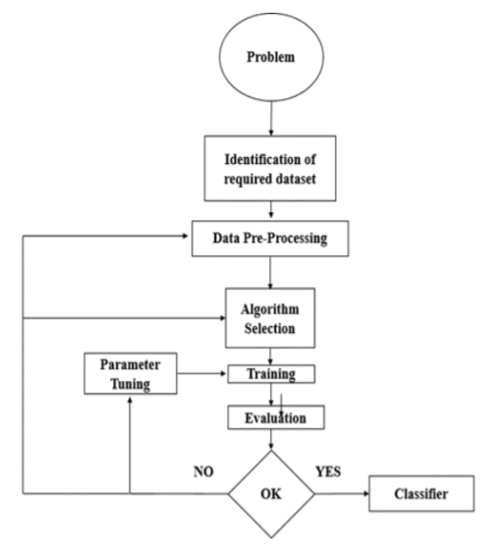
Training Mechanism

Slide 6
Classification and Detection Approach
The following two approaches used in our work for both classification and detection models are:
• Sliding window/Classification Models
• Region proposal/Object Detection Models

Slide 7
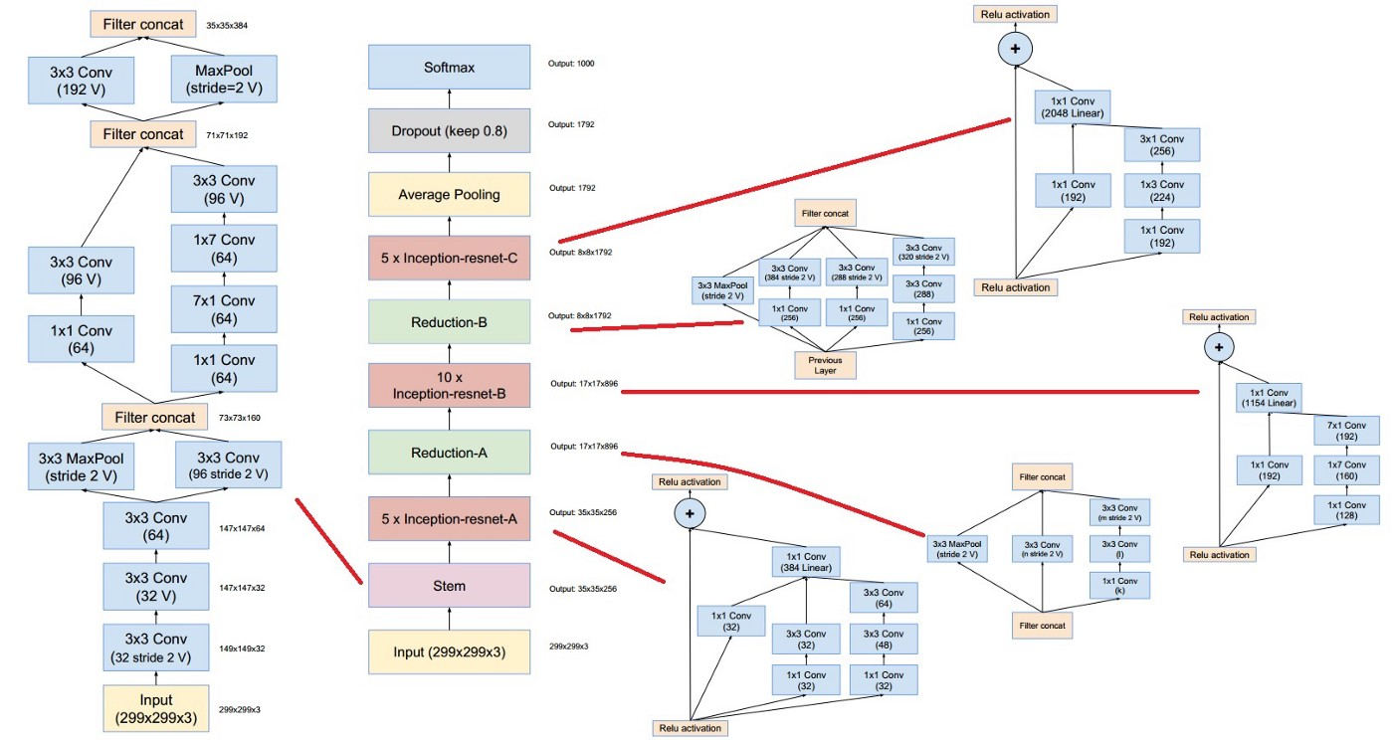
Inception ResNet V2

Slide 8
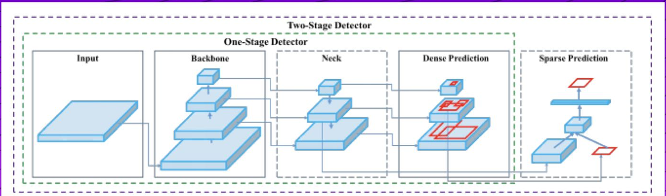
YoloV4 Architecture

Slide 9
Libraries Required
Numpy
Pandas
Tensorflow
Sklearn
Matplotlib
Opencv

Slide 10
Datasets
DATASET CONSTRUCTION AND SELECTION
The task of dataset construction and collection was very important. The datasets are classified as follows:
WEAPON DATASET CATEGORIES FOR PISTOL CLASS
WEAPON DATASET CATEGORIES FOR NOT-PISTOL CLASS

Slide 11
Datasets(Contd…)
The pre-processing process involves data cleaning, standardization, processing, extraction and choice of features, etc.
The final training dataset is the result of pre-processing processes applied to the collected dataset.
Following are the four main steps of data preprocessing:
Image scaling
Data-augmentation
Image labeling
Image Filtering using OpenCV
•RGB to Grayscale
• Equalized
• Clahe

Slide 12
Requirements
Software Requirements:
Operating system : Windows 10 and above
Language Requirement : Python
Hardware requirements:
Processor: i5 processor based computer
Good Internet Connectivity
Memory: 1GB
Hard Drive : 50GB

Slide 13
Thank You

